Slide 1
Business Analysis Fundamentals Knowledge Areas
July 2015

Slide 2
BAF > IntRo to BUSINESS ANALYSIS> WHAT IS BUSINESS ANALYSIS?
BUSINESS ANALYSIS
- the practice of enabling change in an organizational context by defining needs and recommending solutions that deliver value to stakeholders.”
International Institute of Business Analysis-
Body of Knowledge (BABOK) v 3.00

Slide 3

BAF > IntRo to BUSINESS ANALYSIS> BUSINESS ANALYSIS KEY AREAS
Business
System
BA
Customers
Each area must be evaluated to create detailed requirements.

Slide 4


BAF > IntRo to BUSINESS ANALYSIS> BUSINESS ANALYST
Analysis Skills
& Techniques
Business Domain
Knowledge
Business
Analyst
Technical
Domain
Knowledge
Interpersonal / Soft Skills & Professionalism

Slide 5

BAF > IntRo to BUSINESS ANALYSIS> KNOWLEDGE AREAS
KNOWLEDGE AREAS
Knowledge areas define what a practitioner of business analysis needs to understand and the tasks a practitioner must be able to perform.
Business analysts are likely to perform tasks from all knowledge areas in rapid succession, iteratively, or simultaneously. Tasks may be performed in any order as long as the required inputs are available.
Knowledge areas are not intended to represent phases in a project. It is certainly possible and permissible to proceed from performing enterprise analysis activities, to requirements analysis activities, to solution assessment and validation activities, and treat each as a distinct phase in a project.

Slide 6

BAF > IntRo to BUSINESS ANALYSIS>KNOWLEDGE AREAS BABOK
Business Analysis Body of Knowledge (BABOK TM)
Common framework for all perspectives, describing business analysis tasks that are performed to properly analyze a change or evaluate the necessity for a change.
Key Concepts
Knowledge Areas
Tasks
Underlying Competencies
Techniques
Perspectives

Slide 7
BAF > IntRo to BUSINESS ANALYSIS> KNOWLEDGE AREAS > BABOK > COMPARISON
Comparison of Knowledge Areas
BABOK GUIDE V2.00 | BABOK GUIDE V3.00
Business Analysis Planning and Monitoring | Business Analysis Planning and Monitoring
Elicitation | Elicitation and Collaboration
Requirements Management and Communication | Requirements Life Cycle Management
Enterprise Analysis | Strategic Analysis
Requirements Analysis | Requirements Analysis and Design Definition
Solution Assessment and Validation | Solution Evaluation

Slide 8
BAF > IntRo to BUSINESS ANALYSIS> KNOWLEDGE AREAS RELATIONSHIPS
Business Analysis Planning and Monitoring (1)
Strategic Analysis
Requirements Analysis and Design Definition
Elicitation and Collaboration
Requirements Life Cycle Management
Solution Evaluation

Slide 9
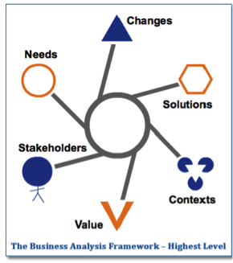
BAF > IntRo to BUSINESS ANALYSIS> KNOWLEDGE AREAS > BACCM
Business Analysis Core Concept Model (BACCM)
- is a tool for analyzing change at any level in an organization including setting organizational strategy to implementing a single feature or component on a small maintenance project.
Business Analysis
“the practice of enabling change in an organizational context by defining needs and recommending solutions that deliver value to stakeholders.”

Slide 10
BAF > IntRo to BUSINESS ANALYSIS> KNOWLEDGE AREAS > BACCM
Core Concept Definition
Core Concept | Definition
Change | a controlled transformation of an organization
Need | a problem, opportunity or constraint with potential value to a stakeholder
Solution | a specific way of satisfying a need in a context
Value | the importance of something to a stakeholder in a context
Stakeholder | a group or individual with a relationship to the change or the solution
Context | the part of the environment that encompasses the change

Slide 11
BAF > IntRo to BUSINESS ANALYSIS> KNOWLEDGE AREAS > BACCM
Core Concept Definition
Change
Solution
Value
Need
Stake-
holder
Context

Slide 12
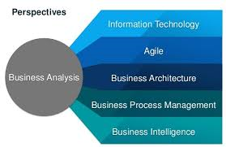
BAF > IntRo to BUSINESS ANALYSIS> KNOWLEDGE AREAS > TERMINOLOGIES

Slide 13

BAF > IntRo to BUSINESS ANALYSIS> KNOWLEDGE AREAS > TERMINOLOGIES
TASKS
A discrete piece of work that may be performed formally or informally as part of business analysis.
Each knowledge area describes the tasks performed by business analysts to accomplish the purpose of that knowledge area.
Each task is presented in the following format:
Purpose
Description
Inputs
Elements
Guidelines
Guidelines / Tools
Techniques
Stakeholders
Outputs

Slide 14
BAF > IntRo to BUSINESS ANALYSIS> KNOWLEDGE AREAS > TERMINOLOGIES
PURPOSE
is a short description of the reason for a business analyst to perform the task and the value created through performing the task.
DESCRIPTION
explains in greater detail why the task is performed, what the task is, and the results the task should accomplish.
INPUT
represents the information and preconditions necessary for a task to begin.
ELEMENTS
describes key concepts that are needed to understand how to perform the task.

Slide 15
BAF > IntRo to BUSINESS ANALYSIS> KNOWLEDGE AREAS > TERMINOLOGIES
TECHNIQUES
provide additional information on different ways that a task may be performed or different forms the output of the task may take.
OUTPUTS
a necessary result of the work described in the task. Outputs are created, transformed or change state as a result of the successful completion of a task. Although a particular output is created and maintained by a single task, a task can have multiple outputs.
STAKEHOLDER
is a group or person who has interests that may be affected by an initiative or influence over it.

Slide 16
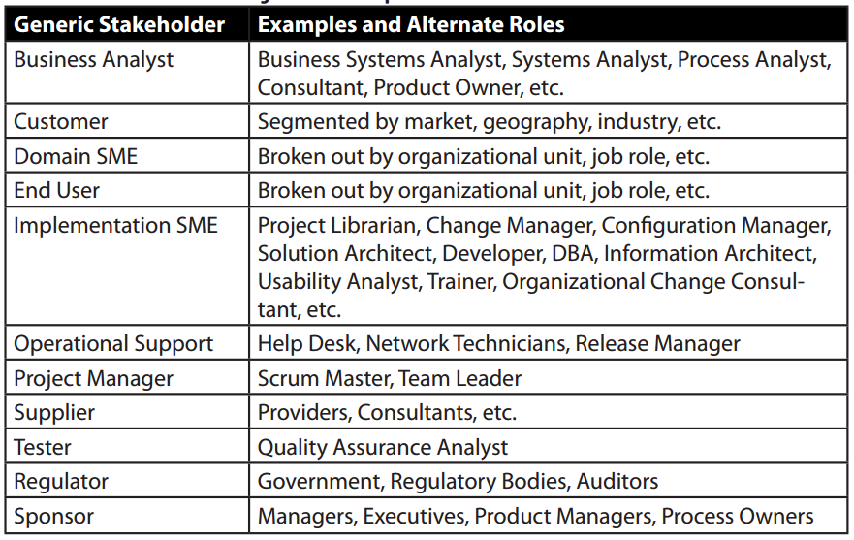
BAF > IntRo to BUSINESS ANALYSIS> KNOWLEDGE AREAS > TERMINOLOGIES

Slide 17

BAF > IntRo to BUSINESS ANALYSIS> KNOWLEDGE AREAS > Business Analysis Planning & Monitoring
Business Analysis Planning & Monitoring
Describes the tasks that Business Analysts perform to organize and coordinate the efforts of business analysts and stakeholders.
These tasks produce outputs that are used as key inputs and guidelines for the other tasks through out the BABOK Guide.
“”What you plan, you have to implement…
What you implement, you have to monitor…”

Slide 18
BAF > IntRo to BUSINESS ANALYSIS> KNOWLEDGE AREAS > Business Analysis Planning & Monitoring
Core Concept Model
Core Concept | Description
Change | Determine how the changes to business analysis results will be requested and authorized
Need | Choose a business analysis approach
Solution | Evaluate if business analysis performance was a key contributor to the successful implementation of the solution
Value | Conduct performance analysis to ensure sufficient value is produced for the stakeholders
Stakeholder | Perform Stakeholder Analysis
Context | Ensure a complete understanding of the context under analysis in order to develop an efficient business analysis approach

Slide 19
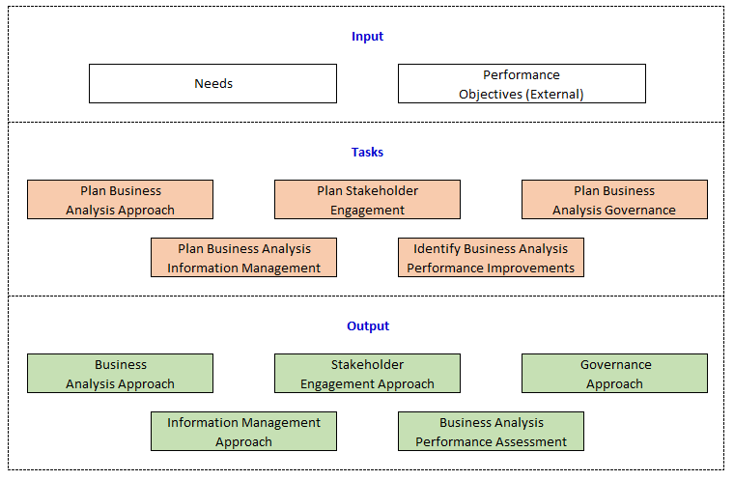
BAF > IntRo to BUSINESS ANALYSIS> KNOWLEDGE AREAS > Business Analysis Planning & Monitoring
Input / Output Diagram

Slide 20
BAF > IntRo to BUSINESS ANALYSIS> KNOWLEDGE AREAS > Business Analysis Planning & Monitoring
Input / Output Diagram

Slide 21

BAF > IntRo to BUSINESS ANALYSIS> KNOWLEDGE AREAS > Business Analysis Planning & Monitoring
Plan Business Analysis Approach - PURPOSE
to define an appropriate method to conduct business analysis activities.
to select an approach to perform business analysis:
which stakeholders need to be involved in the decision
who will be consulted regarding and informed of the approach
why the rationale for using the approach

Slide 22
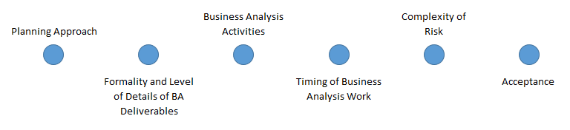
BAF > IntRo to BUSINESS ANALYSIS> KNOWLEDGE AREAS > Business Analysis Planning & Monitoring
Plan Business Analysis Approach - ELEMENTS

Slide 23

BAF > IntRo to BUSINESS ANALYSIS> KNOWLEDGE AREAS > Business Analysis Planning & Monitoring
Planning Approach
Predictive Approach
focuses in minimizing up front uncertainty
preferred where requirements can be effectively
defined in advance
Adaptive Approach
focuses on rapid delivery of business value in short iterations
preferred where taking an exploratory approach

Slide 24
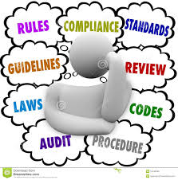
BAF > IntRo to BUSINESS ANALYSIS> KNOWLEDGE AREAS > Business Analysis Planning & Monitoring
Plan Business Analysis Approach – GUIDELINES AND TOOLS
Business Analysis Performance Assessment
Business Policies
Expert Judgment
Methodologies and Frameworks
Stakeholders Engagement Approach

Slide 25
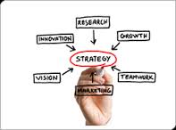
BAF > IntRo to BUSINESS ANALYSIS> KNOWLEDGE AREAS > Business Analysis Planning & Monitoring
Plan Business Analysis Approach – TECHNIQUES
Brainstorming
Business Cases
Document Analysis
Estimation
Financial Analysis
Functional Decomposition
Interviews
Process Modelling
Scope Modelling
Workshops

Slide 26
BAF > IntRo to BUSINESS ANALYSIS> KNOWLEDGE AREAS > Business Analysis Planning & Monitoring
Input / Output Diagram

Slide 27

BAF > IntRo to BUSINESS ANALYSIS> KNOWLEDGE AREAS > Business Analysis Planning & Monitoring
Plan Stakeholder Engagement - PURPOSE
To identify stakeholders who maybe affected by the proposed initiative or who share a common business need.
To identify appropriate stakeholders for the project or project phase.
Determine stakeholder influence and /or authority regarding the approval of project deliverables.

Slide 28
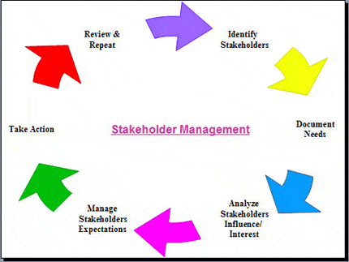
BAF > IntRo to BUSINESS ANALYSIS> KNOWLEDGE AREAS > Business Analysis Planning & Monitoring
Plan Stakeholder Engagement - PURPOSE

Slide 29

BAF > IntRo to BUSINESS ANALYSIS> KNOWLEDGE AREAS > Business Analysis Planning & Monitoring
Plan Stakeholder Engagement - ELEMENTS
Perform Stakeholder Analysis
Define Stakeholder Collaboration.
Stakeholder Communication Needs

Slide 30
BAF > IntRo to BUSINESS ANALYSIS> KNOWLEDGE AREAS > Business Analysis Planning & Monitoring
Plan Stakeholder Engagement - TECHNIQUES
Acceptance and Evaluation Criteria Definition
Brainstorming
Interviews
Organization Modelling
Process Modelling
Requirements Workshops
Risks Analysis
Scenarios and Use Cases
Scope Modelling
Survey / Questionnaire
RASCI Matrix
Stakeholder Map

Slide 31
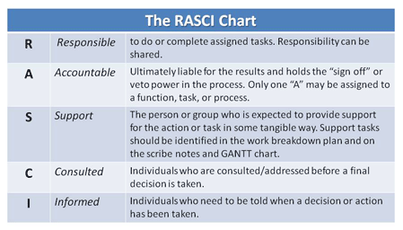
BAF > IntRo to BUSINESS ANALYSIS> KNOWLEDGE AREAS > Business Analysis Planning & Monitoring
Plan Stakeholder Engagement - TECHNIQUES
RASCI Matrix

Slide 32
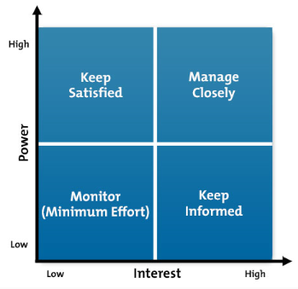
BAF > IntRo to BUSINESS ANALYSIS> KNOWLEDGE AREAS > Business Analysis Planning & Monitoring
Plan Stakeholder Engagement - TECHNIQUES
Stakeholder Map

Slide 33

ExerCISE 4
ACSS Development Situation Analysis
(Continuation)
Planning Stakeholder Engagement
(15 – 20 Minutes Exercise)
Notes:
>Refer to EXercise2

Slide 34
BAF > IntRo to BUSINESS ANALYSIS> KNOWLEDGE AREAS > Business Analysis Planning & Monitoring
Input / Output Diagram

Slide 35

BAF > IntRo to BUSINESS ANALYSIS> KNOWLEDGE AREAS > Business Analysis Planning & Monitoring
Plan Business Analysis Governance - PURPOSE
To define how decisions are made on:
Requirements and Designs
Change Control Approvals
Prioritization

Slide 36

BAF > IntRo to BUSINESS ANALYSIS> KNOWLEDGE AREAS > Business Analysis Planning & Monitoring
Plan Business Analysis Governance - ELEMENTS
Decision Making
Change Control Process
Plan Prioritization Approach
Plan for Approvals

Slide 37
BAF > IntRo to BUSINESS ANALYSIS> KNOWLEDGE AREAS > Business Analysis Planning & Monitoring
Plan Business Analysis Governance - ELEMENTS
Change Control Process
Determine the process for requesting changes
Determine the elements of the change request
Cost and Time Estimates
Benefits / Risks
Priority
Course(s) of Action
Determine how the changes will be prioritized, documented and communicated
Determine who will perform the impact analysis
Determine who will authorize the changes

Slide 38

BAF > IntRo to BUSINESS ANALYSIS> KNOWLEDGE AREAS > Business Analysis Planning & Monitoring
Plan Business Analysis Governance - TECHNIQUES
Brainstorming
Document Analysis
Item Tracking
Interviews
Process Modelling
Reviews
Survey
Workshops
Lessons Learned

Slide 39
BAF > IntRo to BUSINESS ANALYSIS> KNOWLEDGE AREAS > Business Analysis Planning & Monitoring
Input / Output Diagram

Slide 40

BAF > IntRo to BUSINESS ANALYSIS> KNOWLEDGE AREAS > Business Analysis Planning & Monitoring
Plan Business Analysis Information Management - PURPOSE
To develop an approach for how business analysis information will be stored and accessed.

Slide 41

BAF > IntRo to BUSINESS ANALYSIS> KNOWLEDGE AREAS > Business Analysis Planning & Monitoring
Plan Business Analysis Information Management - TECHNIQUES
Brainstorming
Mind Mapping
Item Tracking
Lessons Learned
Process Modelling
Survey
Workshops

Slide 42
BAF > IntRo to BUSINESS ANALYSIS> KNOWLEDGE AREAS > Business Analysis Planning & Monitoring
Input / Output Diagram

Slide 43
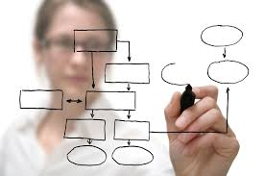
BAF > IntRo to BUSINESS ANALYSIS> KNOWLEDGE AREAS > Business Analysis Planning & Monitoring
Identify Business Analysis Performance Improvements - Purpose
To assess business analysis work and to plan to improve where processes where required.

Slide 44
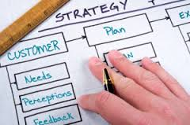
BAF > IntRo to BUSINESS ANALYSIS> KNOWLEDGE AREAS > Business Analysis Planning & Monitoring
Identify Business Analysis Performance Improvements - ELEMENTS
Performance Analysis
Assessment Measures
Analyze Results
Recommend Action

Slide 45

BAF > IntRo to BUSINESS ANALYSIS> KNOWLEDGE AREAS > Business Analysis Planning & Monitoring
Identify Business Analysis Performance Improvements - ELEMENTS
POSSIBLE MEASURES (for BA’s Performance)
Accuracy and Completeness
Knowledge
Effectiveness
Organizational Support
Significance
Strategic
Timeliness

Slide 46

BAF > IntRo to BUSINESS ANALYSIS> KNOWLEDGE AREAS > Business Analysis Planning & Monitoring
Identify Business Analysis Performance Improvements - ELEMENTS
Recommend Actions
Preventive
Corrective
Improvement

Slide 47

BAF > IntRo to BUSINESS ANALYSIS> KNOWLEDGE AREAS > Business Analysis Planning & Monitoring
Identify Business Analysis Performance Improvements - TECHNIQUES
Lessons Learned Process
Interviews
Metrics and KPI
Item Tracking
Process Modelling / Analysis
Root Cause Analysis
Survey / Questionnaire
Observation
Risk Analysis and Management

Slide 48

BAF > IntRo to BUSINESS ANALYSIS> KNOWLEDGE AREAS > ELICITATION AND COLLABORATION
Elicitation and Collaboration
Describes the tasks that business analyst perform to obtain information from stakeholders and confirm the results.
The communication with stakeholders once the business analysis information is assembled.
Always on going as long as business analysis work is occurring.

Slide 49
BAF > IntRo to BUSINESS ANALYSIS> KNOWLEDGE AREAS > ELICITATION AND COLLABORATION
Core Concept Model
Core Concept | Description
Change | BA uses a variety of elicitation techniques to fully understand the characteristics and concerns that stakeholders have about the change.
Need | Elicit, confirm and communicate needs and supporting business analysis information.
Solution | Elicit, confirm and communicate necessary or desired characteristics of proposed solutions.
Value | Collaborate with Stakeholders to assess the relative value of information provided through elicitation and apply a variety of techniques to confirm and communicate that value.

Slide 50
BAF > IntRo to BUSINESS ANALYSIS> KNOWLEDGE AREAS > ELICITATION AND COLLABORATION
Core Concept Model
Core Concept | Description
Stakeholder | Manage the collaboration with the stakeholders who participate in the business analysis work.
Context | Apply a variety of elicitation techniques to identify business analysis information about the context that may affect the change.

Slide 51
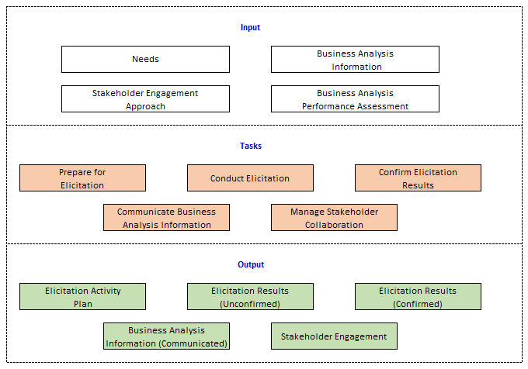
BAF > IntRo to BUSINESS ANALYSIS> KNOWLEDGE AREAS > ELICITATION AND COLLABORATION
Input / Output Diagram

Slide 52
BAF > IntRo to BUSINESS ANALYSIS> KNOWLEDGE AREAS > ELICITATION AND COLLABORATION
Input / Output Diagram

Slide 53

BAF > IntRo to BUSINESS ANALYSIS> KNOWLEDGE AREAS > ELICITATION AND COLLABORATION
Prepare for Elicitation - PURPOSE
To understand the scope of the elicitation activity, select appropriate techniques, and plan for (or procure) appropriate supporting materials and resources.

Slide 54
BAF > IntRo to BUSINESS ANALYSIS> KNOWLEDGE AREAS > ELICITATION AND COLLABORATION
Input / Output Diagram

Slide 55

BAF > IntRo to BUSINESS ANALYSIS> KNOWLEDGE AREAS > ELICITATION AND COLLABORATION
Conduct Elicitation - PURPOSE
To draw out, explore, and identify information relevant to the change.

Slide 56
BAF > IntRo to BUSINESS ANALYSIS> KNOWLEDGE AREAS > ELICITATION AND COLLABORATION
Input / Output Diagram

Slide 57

BAF > IntRo to BUSINESS ANALYSIS> KNOWLEDGE AREAS > ELICITATION AND COLLABORATION
Confirm Elicitation Results - PURPOSE
To check the information gathered during an elicitation session for accuracy and consistency with other information.

Slide 58
BAF > IntRo to BUSINESS ANALYSIS> KNOWLEDGE AREAS > ELICITATION AND COLLABORATION
Input / Output Diagram

Slide 59

BAF > IntRo to BUSINESS ANALYSIS> KNOWLEDGE AREAS > ELICITATION AND COLLABORATION
Communicate Business Analysis Information - PURPOSE
To ensure stakeholders have a shared understanding of business analysis information

Slide 60
BAF > IntRo to BUSINESS ANALYSIS> KNOWLEDGE AREAS > ELICITATION AND COLLABORATION
Input / Output Diagram

Slide 61

BAF > IntRo to BUSINESS ANALYSIS> KNOWLEDGE AREAS > ELICITATION AND COLLABORATION
Manage Stakeholder Collaboration - PURPOSE
To encourage stakeholders to work towards a common goal.

Slide 62
BAF > IntRo to BUSINESS ANALYSIS> KNOWLEDGE AREAS > ELICITATION AND COLLABORATION
ELICITATION TECHNIQUES
Brainstorming
Mind Mapping
Process Modelling
Process Analysis
Document Analysis
Interface Analysis
Interview
Observation
Prototyping
Workshops
Collaborative Games
Business Rule Analysis
Survey

Slide 63
ExerCISE 5
ACSS Development Situation Analysis
Choose a project you are very much involved with.
List down requirements that you have elicited from all of the stakeholders.
(10 – 15 Minutes Exercise)
Notes:
>Refer to EXercise2

Slide 64

BAF > IntRo to BUSINESS ANALYSIS> KNOWLEDGE AREAS > REQUIREMENTS LIFE CYCLE MANAGEMENT
Requirements Life Cycle Management
Describes the tasks that business analysts perform in order to manage and maintain requirements and design information from inception to retirement.
The purpose of requirements life cycle management is to ensure that business, stakeholder and solution requirements and designs are aligned to one another and that the solution implements them.

Slide 65
BAF > IntRo to BUSINESS ANALYSIS> KNOWLEDGE AREAS > REQUIREMENTS LIFE CYCLE MANAGEMENT
Requirements Life Cycle Management
Assess
Approval/
Consensus
Trace
Maintain
Prioritize
Yes
Yes
No
No
Potential
Requirement

Slide 66
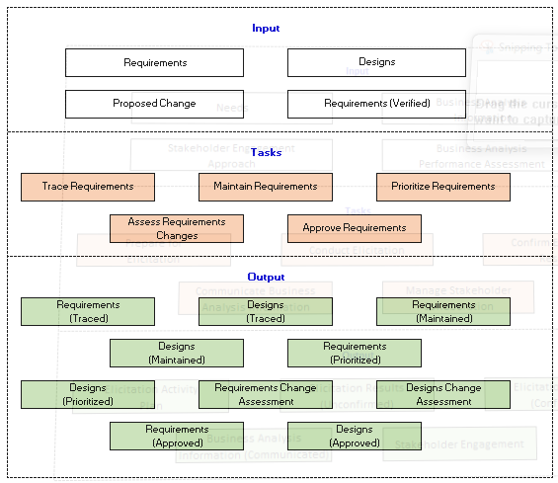
BAF > IntRo to BUSINESS ANALYSIS> KNOWLEDGE AREAS > REQUIREMENTS LIFE CYCLE MANAGEMENT
Input / Output Diagram

Slide 67
BAF > IntRo to BUSINESS ANALYSIS> KNOWLEDGE AREAS > REQUIREMENTS LIFE CYCLE MANAGEMENT
Core Concept Model
Core Concept | Description
Change | Manage how proposed changes to requirements and designs are evaluated during an initiative
Need | Trace, prioritize and maintain requirements to ensure that the need is met.
Solution | Trace requirements and designs to solution components to ensure that the solution satisfies the need.
Value | Maintain requirements for reuse to extend value beyond the current initiative

Slide 68
BAF > IntRo to BUSINESS ANALYSIS> KNOWLEDGE AREAS > REQUIREMENTS LIFE CYCLE MANAGEMENT
Core Concept Model
Core Concept | Description
Stakeholder | Work closely with key stakeholders to maintain understanding, agreement and approval of requirements and designs.
Context | Analyze the context to support tracing and prioritization activities.

Slide 69
BAF > IntRo to BUSINESS ANALYSIS> KNOWLEDGE AREAS > REQUIREMENTS LIFE CYCLE MANAGEMENT
Input / Output Diagram

Slide 70

BAF > IntRo to BUSINESS ANALYSIS> KNOWLEDGE AREAS > REQUIREMENTS LIFE CYCLE MANAGEMENT
Trace Requirements- PURPOSE
To ensure that requirements and designs at different levels are aligned to one another.
To manage the effects of change to one level on related requirements.

Slide 71

BAF > IntRo to BUSINESS ANALYSIS> KNOWLEDGE AREAS > REQUIREMENTS LIFE CYCLE MANAGEMENT
Trace Requirements- PURPOSE
TRACING
“Tracing” a requirement refers to the ability to look at a requirement and the others to which it is related.
Tracing links business requirements to stakeholder and solution requirements, to other artifacts produced by the team and to solution components.

Slide 72
BAF > IntRo to BUSINESS ANALYSIS> KNOWLEDGE AREAS > REQUIREMENTS LIFE CYCLE MANAGEMENT
Input / Output Diagram

Slide 73

BAF > IntRo to BUSINESS ANALYSIS> KNOWLEDGE AREAS > REQUIREMENTS LIFE CYCLE MANAGEMENT
Maintain Requirements- PURPOSE
To retain requirement accuracy and consistency throughout and beyond the change during the entire requirements life cycle and to support reuse of requirements in other solution.

Slide 74

BAF > IntRo to BUSINESS ANALYSIS> KNOWLEDGE AREAS > REQUIREMENTS LIFE CYCLE MANAGEMENT
Maintain Requirements
For Reuse
Identify requirements that are candidates for a long-term usage by the organization.
To reuse requirements they must be clearly named and defined.
Should be easily available to other analysts.

Slide 75
BAF > IntRo to BUSINESS ANALYSIS> KNOWLEDGE AREAS > REQUIREMENTS LIFE CYCLE MANAGEMENT
Input / Output Diagram

Slide 76
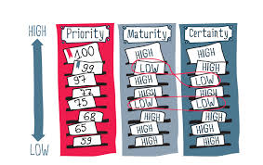
BAF > IntRo to BUSINESS ANALYSIS> KNOWLEDGE AREAS > REQUIREMENTS LIFE CYCLE MANAGEMENT
Prioritize Requirements- PURPOSE
To rank requirements in the order of relative importance.
Prioritization is the act of ranking requirements to determine their relative importance to stakeholders.

Slide 77
BAF > IntRo to BUSINESS ANALYSIS> KNOWLEDGE AREAS > REQUIREMENTS LIFE CYCLE MANAGEMENT
Prioritize Requirements
CRITERIA FOR PRIORITIZATION
Business Value
Business or Technical Risk
Implementation Difficulty
Likelihood of Success
Regulatory or Policy Compliance
Relationship to other Requirements
Stakeholder Agreement
Stability

Slide 78
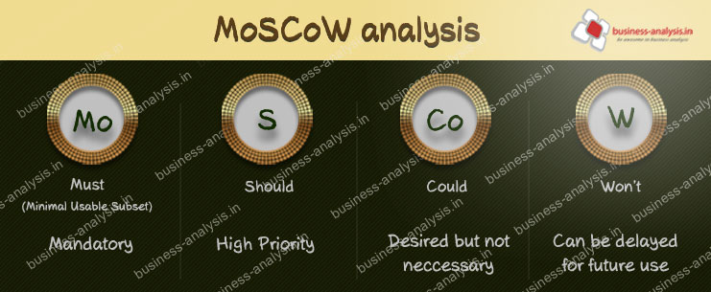
BAF > IntRo to BUSINESS ANALYSIS> KNOWLEDGE AREAS > REQUIREMENTS LIFE CYCLE MANAGEMENT
Prioritize Requirements

Slide 79
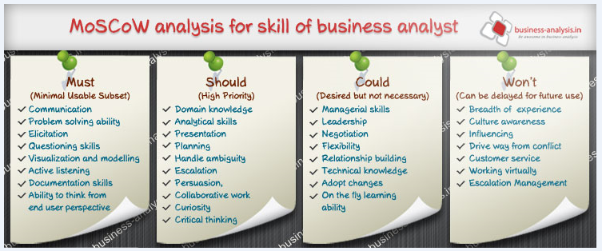
BAF > IntRo to BUSINESS ANALYSIS> KNOWLEDGE AREAS > REQUIREMENTS LIFE CYCLE MANAGEMENT

Slide 80
BAF > IntRo to BUSINESS ANALYSIS> KNOWLEDGE AREAS > REQUIREMENTS LIFE CYCLE MANAGEMENT
Input / Output Diagram

Slide 81
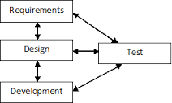
BAF > IntRo to BUSINESS ANALYSIS> KNOWLEDGE AREAS > REQUIREMENTS LIFE CYCLE MANAGEMENT
Assess Requirements Changes - PURPOSE
To evaluate the implications of proposed changes to requirements and designs.

Slide 82
BAF > IntRo to BUSINESS ANALYSIS> KNOWLEDGE AREAS > REQUIREMENTS LIFE CYCLE MANAGEMENT
Input / Output Diagram

Slide 83

BAF > IntRo to BUSINESS ANALYSIS> KNOWLEDGE AREAS > REQUIREMENTS LIFE CYCLE MANAGEMENT
Approve Requirements Changes - PURPOSE
To obtain agreement on approval of requirements and designs for business analysis work to continue and/or solution construction to proceed.

Slide 84

ExerCISE 6
ACSS Development Situation Analysis
Create a MoSCoW Table for the requirements you have listed in Exercise 5.
(10 – 15 Minutes Exercise)
Notes:
>Refer to EXercise2

Slide 85

BAF > IntRo to BUSINESS ANALYSIS> KNOWLEDGE AREAS > STRATEGY ANALYSIS
STRATEGY ANALYSIS
Describes the business analysis work that must be performed to collaborate with stakeholders in order to identify a need of strategic or tactical importance, enable the enterprise to address that need and align the resulting strategy for the change with higher and lower level strategies.

Slide 86
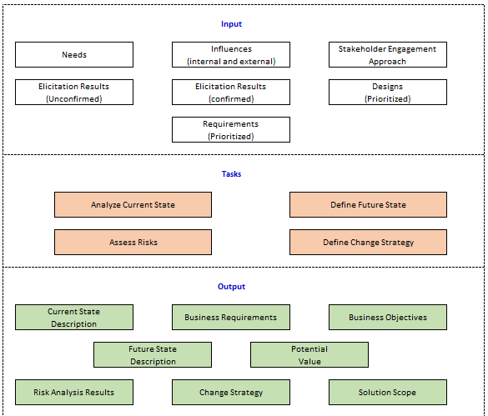
BAF > IntRo to BUSINESS ANALYSIS> KNOWLEDGE AREAS > STRATEGY ANALYSIS
Input / Output Diagram

Slide 87
BAF > IntRo to BUSINESS ANALYSIS> KNOWLEDGE AREAS > STRATEGY ANALYSIS
Core Concept Model
Core Concept | Description
Change | Define the future state and develop the change strategy to achieve the future state.
Need | Identify needs within the current state and prioritize needs to determine the desired future state.
Solution | Define the scope of a solution as part of developing a change strategy.
Value | Examine the potential value of a solution to determine if a change is justified.

Slide 88
BAF > IntRo to BUSINESS ANALYSIS> KNOWLEDGE AREAS > STRATEGY ANALYSIS
Core Concept Model
Core Concept | Description
Stakeholder | Collaborate with stakeholders to understand the business need and to develop a change strategy and future state that will cater to those needs.
Context | Consider the context of the enterprise in a developing strategy.

Slide 89
BAF > IntRo to BUSINESS ANALYSIS> KNOWLEDGE AREAS > STRATEGY ANALYSIS
Input / Output Diagram

Slide 90

BAF > IntRo to BUSINESS ANALYSIS> KNOWLEDGE AREAS > STRATEGY ANALYSIS
Analyze Current State - PURPOSE
To understand the reasons why an enterprise needs to change some aspect of how it operates and what would be directly or indirectly affected by the change.

Slide 91
BAF > IntRo to BUSINESS ANALYSIS> KNOWLEDGE AREAS > STRATEGY ANALYSIS
Analyze Current State
Define Business Need
To the most critical step in business analysis effort.
Business needs will drive the over all analysis of the current state.

Slide 92
BAF > IntRo to BUSINESS ANALYSIS> KNOWLEDGE AREAS > STRATEGY ANALYSIS
Input / Output Diagram

Slide 93
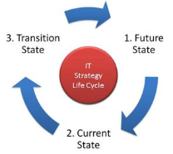
BAF > IntRo to BUSINESS ANALYSIS> KNOWLEDGE AREAS > STRATEGY ANALYSIS
Define Future State - PURPOSE
To determine the set of necessary conditions to meet the business need.

Slide 94
BAF > IntRo to BUSINESS ANALYSIS> KNOWLEDGE AREAS > STRATEGY ANALYSIS
Define Future State
Business Goals and Objectives
Strategic Framework Measures Framework
Mission
Vision
Goals
Objectives
Action Plans
Long Term Outcome Measures
Top – Down,
Bottom – Up
Strategic Alignment
Short Term Outcome Measures
Output Measures
Process Measures

Slide 95

BAF > IntRo to BUSINESS ANALYSIS> KNOWLEDGE AREAS > STRATEGY ANALYSIS
Define Future State
Scope of Solution Space
Changes to the Organizational Structure
or culture
Capabilities and processes
Technology and infrastructure
Policies, products or services
Creating or Changing relationships with
organizations currently outside the
scope of the extended enterprise.
Notes:
Diff bet problem / requirements

Slide 96
BAF > IntRo to BUSINESS ANALYSIS> KNOWLEDGE AREAS > STRATEGY ANALYSIS
Input / Output Diagram

Slide 97

BAF > IntRo to BUSINESS ANALYSIS> KNOWLEDGE AREAS > STRATEGY ANALYSIS
Assess RISKS - PURPOSE
To understand the undesirable consequences of internal and external forces on the enterprise during a transition to, or once in, the future state,

Slide 98

BAF > IntRo to BUSINESS ANALYSIS> KNOWLEDGE AREAS > STRATEGY ANALYSIS
Assess RISKS - ELEMENTS
Unknowns
Constraints, Assumptions and Dependencies
Negative Impact to Value
Risk Tolerance
Recommendation

Slide 99
BAF > IntRo to BUSINESS ANALYSIS> KNOWLEDGE AREAS > STRATEGY ANALYSIS
Input / Output Diagram

Slide 100

BAF > IntRo to BUSINESS ANALYSIS> KNOWLEDGE AREAS > STRATEGY ANALYSIS
Define Change Strategy- PURPOSE
To develop and assess alternative approaches to the change, and then select the recommended approach.

Slide 101
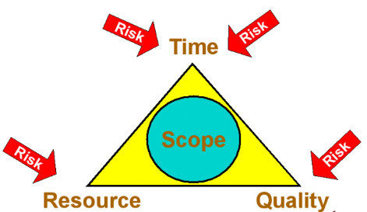
BAF > IntRo to BUSINESS ANALYSIS> KNOWLEDGE AREAS > STRATEGY ANALYSIS
Define Change Strategy- ELEMENTS
Solution Scope
Gap Analysis
Enterprise Readiness Assessment
Change Strategy
Transition States and Release Planning

Slide 102
Exercise 7
ACSS Development Situation Analysis
Let Us Strategize!
(15 – 20 Minutes Group Exercise)

Slide 103
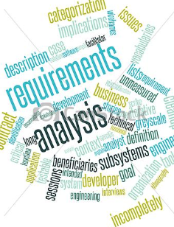
BAF > IntRo to BUSINESS ANALYSIS> KNOWLEDGE AREAS > Requirements analysis and design definition
Requirements Analysis and Design Definition
Structure and organize requirements discovered during elicitation activities.
Specify and model requirements and designs
Validate and verify information
Identify solution options that meet business needs
Estimate the potential value that could be realized for each solution option.

Slide 104
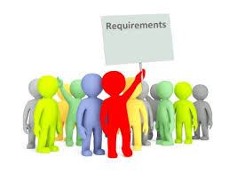
BAF > IntRo to BUSINESS ANALYSIS> KNOWLEDGE AREAS > Requirements analysis and design definition
Requirements
A condition or capability needed by a stakeholder to solve a problem or achieve an objective.
A condition or capability that must be met or possessed by a system
A documented representation of a condition or
capability as in (1) or (2).

Slide 105
BAF > IntRo to BUSINESS ANALYSIS> KNOWLEDGE AREAS > Requirements analysis and design definition
Requirement Categories
Business Requirements | Customer Requirements | System Requirements
Define Business Needs Management Constraints Expectations Include Schedule Budget Business Process Changes Organizational Impacts Financial Objectives | Independent of Technology Do not mention particulars Serves as the basis for function points Include current and requested process flows | Identify hardware, software and communication infrastructure required to fulfill customer requirements. Define Quality Interface / Data Security / Control Performance Operations and Support Availability

Slide 106

BAF > IntRo to BUSINESS ANALYSIS> KNOWLEDGE AREAS > Requirements analysis and design definition
Importance of Good Requirements
Good requirements assist the project in managing scope and costs.
Communicating to the client that getting the requirements right will:
Meet Project deadlines
Maintain the project scope
Promote Communication
Satisfy Customer Needs
Lower Project Costs

Slide 107

BAF > IntRo to BUSINESS ANALYSIS> KNOWLEDGE AREAS > Requirements analysis and design definition
Requirements Classification – Business Requirements
Higher level statements of the goals, objectives or needs of the enterprise.
Describe
The reasons why a project is initiated.
The objectives that the project will achieve.
The metrics which will be used to measure its success.

Slide 108

BAF > IntRo to BUSINESS ANALYSIS> KNOWLEDGE AREAS > Requirements analysis and design definition
Requirements Classification – Stakeholder Requirements
Higher level statements of the goals, objectives or needs of the enterprise.
Describe
The needs that a given stakeholder has and how that stakeholder will interact with a solution.
Serve as a bridge between Business Requirements and the various classes of solution requirements.

Slide 109

BAF > IntRo to BUSINESS ANALYSIS> KNOWLEDGE AREAS > Requirements analysis and design definition
Requirements Classification – Solution Requirements
Describes the characteristics of a solution that meet the business and stakeholder needs.
Developed and defined through requirement analysis
Functional Requirements
Non Functional Requirements

Slide 110

BAF > IntRo to BUSINESS ANALYSIS> KNOWLEDGE AREAS > Requirements analysis and design definition
Requirements Classification – Transition Requirements
Describe capabilities that the solution must have in order:
To facilitate transition from the current state of the enterprise to the desired future state.
That will not be needed once that transition is complete
Temporary in nature.

Slide 111





BAF > IntRo to BUSINESS ANALYSIS> KNOWLEDGE AREAS > Requirements analysis and design definition
Sources of Requirements
Customers
Partners
Users
Domain Experts

Slide 112

BAF > IntRo to BUSINESS ANALYSIS> KNOWLEDGE AREAS > Requirements analysis and design definition
Problems with Requirements
Incorrect requirements based on poorly defined needs.
Imprecise and ambiguous requirements
Language – related problems
Deliberate imprecision for flexibility
Human conflict prevents consensus
Inherently nebulous information – age projects
Customers’ lack of expertise
Oversights by project planners
Shifting requirements

Slide 113

BAF > IntRo to BUSINESS ANALYSIS> KNOWLEDGE AREAS > Requirements analysis and design definition
General Guidelines for Specifying Requirements
Rule 1: State the requirement explicitly and have customers sign off on it.
Rule 2: Be REALISTIC - assume that if a requirement can be misinterpreted, it will be misinterpreted.
Rule 3: Be REALISTIC - recognize that there will be changes in your project and that things will not go precisely as anticipated.
Rule 4: To as great an extent as possible, include pictures, graphs, physical models, and other nonverbal exhibits in the formulation of requirements.

Slide 114
BAF > IntRo to BUSINESS ANALYSIS> KNOWLEDGE AREAS > Requirements analysis and design definition
General Guidelines for Specifying Requirements
Rule 5: Establish a system to monitor carefully any changes made to requirements including:
Date of Change Request
Name of Person Requesting the Change
Description of the Change
Statement of the Change’s impact on the project
List of tasks and staff affected by the change
Estimate of the cost of the change request, indicating
that this individual is aware of the cost and performance
impacts of the requested change.
Rule 6: Educate project staff and customers regarding the
problems of specifying requirements.

Slide 115

BAF > IntRo to BUSINESS ANALYSIS> KNOWLEDGE AREAS > Requirements analysis and design definition
Qualities of a Good Software Requirements
Understandable
Complete
Verifiable
Unambiguous
Modifiable
Traceable
Consistent
Accurate

Slide 116
BAF > IntRo to BUSINESS ANALYSIS> KNOWLEDGE AREAS > Requirements analysis and design definition
Core Concept Model
Core Concept | Description
Change | Transform elicitation results into requirements and designs in order to define the change
Need | Analyze the needs in order to recommend a solution that meets the needs.
Solution | Define solution options and recommend the ones that is most likely to address the need and has the most value.
Value | Analyze and quantify the potential value of the solutions.

Slide 117
BAF > IntRo to BUSINESS ANALYSIS> KNOWLEDGE AREAS > Requirements analysis and design definition
Core Concept Model
Core Concept | Description
Stakeholder | Tailor the requirements and designs to that they are understandable and usable by each stakeholder group.
Context | Model and describe the context in formats that are understandable and usable by all stakeholders.

Slide 118
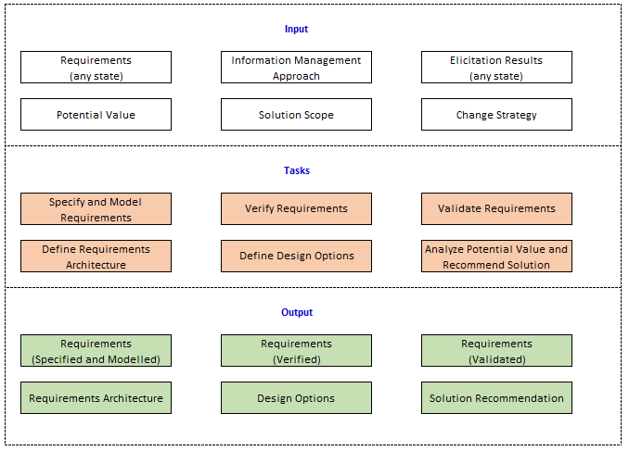
BAF > IntRo to BUSINESS ANALYSIS> KNOWLEDGE AREAS > Requirements analysis and design definition
Input / Output Diagram

Slide 119
BAF > IntRo to BUSINESS ANALYSIS> KNOWLEDGE AREAS > Requirements analysis and design definition
Input / Output Diagram

Slide 120
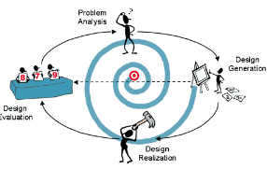
BAF > IntRo to BUSINESS ANALYSIS> KNOWLEDGE AREAS > Requirements analysis and design definition
Specify and Model Requirements - PURPOSE
To analyze, synthetize and refine elicitation results into requirements and designs.

Slide 121
BAF > IntRo to BUSINESS ANALYSIS> KNOWLEDGE AREAS > Requirements analysis and design definition
Specify and Model Requirements - PURPOSE
MODEL REQUIREMENTS
A model is a descriptive and visual way to convey information to a specific audience in order to support analysis, communication and understanding.
Models may also be used to confirm knowledge, identify information gaps that the business analyst may have and identify duplicate information.

Slide 122
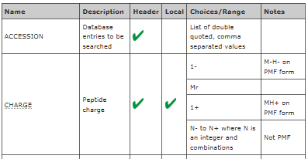
BAF > IntRo to BUSINESS ANALYSIS> KNOWLEDGE AREAS > Requirements analysis and design definition
Specify and Model Requirements - PURPOSE
TWO TYPES OF MODELLING FORMAT
Matrices
→ Used for date dictionaries, requirements traceability, or for gap analysis.
→ Used for prioritizing requirements and recording other requirements attributes and metadata.

Slide 123
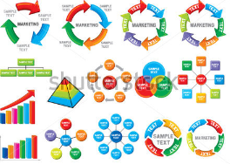
BAF > IntRo to BUSINESS ANALYSIS> KNOWLEDGE AREAS > Requirements analysis and design definition
Specify and Model Requirements - PURPOSE
TWO TYPES OF MODELLING FORMAT
Diagram
Useful to depict complexity in a way that would be difficult to do with words.
Used to define boundaries for business domains, to categorize and create hierarchies of items, and to show components of objects such as data and their relationships.

Slide 124
BAF > IntRo to BUSINESS ANALYSIS> KNOWLEDGE AREAS > Requirements analysis and design definition
Input / Output Diagram

Slide 125

BAF > IntRo to BUSINESS ANALYSIS> KNOWLEDGE AREAS > Requirements analysis and design definition
Verify Requirements - PURPOSE
To ensure that requirements and designs specifications and models meet quality standards and are usable for the purpose they serve.

Slide 126
BAF > IntRo to BUSINESS ANALYSIS> KNOWLEDGE AREAS > Requirements analysis and design definition
Input / Output Diagram

Slide 127
BAF > IntRo to BUSINESS ANALYSIS> KNOWLEDGE AREAS > Requirements analysis and design definition
Validate Requirements - PURPOSE
To ensure that requirements and designs align to the business requirements and support the delivery of needed value.

Slide 128
BAF > IntRo to BUSINESS ANALYSIS> KNOWLEDGE AREAS > Requirements analysis and design definition
Input / Output Diagram

Slide 129
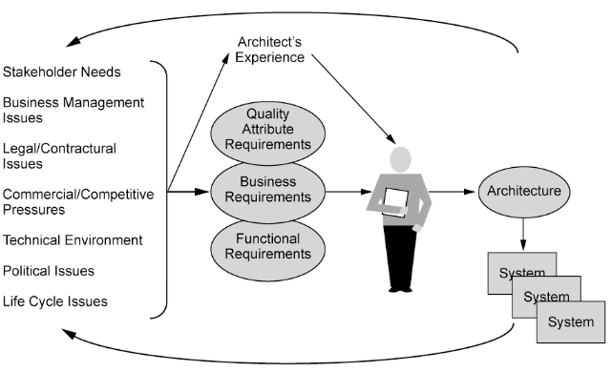
BAF > IntRo to BUSINESS ANALYSIS> KNOWLEDGE AREAS > Requirements analysis and design definition
Define Requirements Architecture - PURPOSE
To ensure that the requirements collectively support one another to fully achieve the objectives.

Slide 130
BAF > IntRo to BUSINESS ANALYSIS> KNOWLEDGE AREAS > Requirements analysis and design definition
Define Requirements Architecture – PURPOSE
REQUIREMENTS ARCHITECTURE
Is the structure of all of the requirements of a change
Fits the individual models and specifications together to ensure that all of the requirements form a single whole that supports the overall business objectives and produces a useful outcome for stakeholders.

Slide 131
BAF > IntRo to BUSINESS ANALYSIS> KNOWLEDGE AREAS > Requirements analysis and design definition
Input / Output Diagram

Slide 132
BAF > IntRo to BUSINESS ANALYSIS> KNOWLEDGE AREAS > Requirements analysis and design definition
Define Design Options – PURPOSE
To define the solution approach, identify opportunities to improve the business, allocate requirements across solution components, and represent design options that achieve the desire future state.
Past State
Current State Transition
Future State

Slide 133
BAF > IntRo to BUSINESS ANALYSIS> KNOWLEDGE AREAS > Requirements analysis and design definition
Define Design Options – PURPOSE
DEFINE SOLUTION APPROACH
The solution approach describes whether solution components will be created or purchased, or some combination of both.
Business Analysts assess the merits of the solution approaches for each design option.

Slide 134
BAF > IntRo to BUSINESS ANALYSIS> KNOWLEDGE AREAS > Requirements analysis and design definition
Input / Output Diagram

Slide 135

BAF > IntRo to BUSINESS ANALYSIS> KNOWLEDGE AREAS > Requirements analysis and design definition
Analyze Potential Value and Recommend Solution– PURPOSE
To estimate the potential value for each design option and to establish which is most appropriate to meet the enterprise’s requirements.

Slide 136

BAF > IntRo to BUSINESS ANALYSIS> KNOWLEDGE AREAS > Requirements analysis and design definition
Analyze Potential Value and Recommend Solution– PURPOSE
Factors to Consider:
Available Resources
Constraints on the Solution
Dependencies Between Requirements

Slide 137
Exercise 8
ACSS Development Situation Analysis
Requirements Classification

Slide 138

BAF > IntRo to BUSINESS ANALYSIS> KNOWLEDGE AREAS >
Solution Evaluation
This describes the tasks that business analysts perform to assess the performance of/and value delivered by a solution in use by the enterprise, and to recommend removal of barriers or constraints that prevent the full realization of the value.

Slide 139
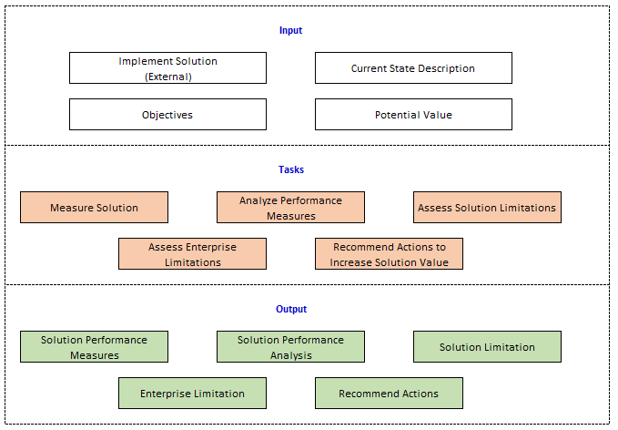
BAF > IntRo to BUSINESS ANALYSIS> KNOWLEDGE AREAS > SOLUTION EVALUATION
Input / Output Diagram

Slide 140
BAF > IntRo to BUSINESS ANALYSIS> KNOWLEDGE AREAS > SOLUTION EVALUATION
Core Concept Model
Core Concept | Description
Change | Recommend a change to either a solution or the enterprise in order to realize the potential value of a solution
Need | Evaluate how a solution or solution component is fulfilling the need.
Solution | Assess the performance of the solution
Value | Determine if the solution is delivering the potential value and examine why value may not be being realized.
Stakeholder | Elicit information from the stakeholders about solution performance and value delivery.
Context | Consider the context in determining solution performance measures and any limitations within the context that may prohibit value from being realized.

Slide 141
BAF > IntRo to BUSINESS ANALYSIS> KNOWLEDGE AREAS > SOLUTION EVALUATION
Input / Output Diagram

Slide 142

BAF > IntRo to BUSINESS ANALYSIS> KNOWLEDGE AREAS > SOLUTION EVALUATION
Measure Solution Performance– PURPOSE
To define performance measures and use the data collected to evaluate the effectiveness of a solution in relation to the value it brings.

Slide 143
BAF > IntRo to BUSINESS ANALYSIS> KNOWLEDGE AREAS > SOLUTION EVALUATION
Measure Solution Performance
Define Solution Performance Measures
Validate Performance Measures
Collect Performance Measures

Slide 144
BAF > IntRo to BUSINESS ANALYSIS> KNOWLEDGE AREAS > SOLUTION EVALUATION
Input / Output Diagram

Slide 145

BAF > IntRo to BUSINESS ANALYSIS> KNOWLEDGE AREAS > SOLUTION EVALUATION
Analyze Performance Measures – PURPOSE
To provide insights into the performance of a solution in relation to the value it brings.

Slide 146
BAF > IntRo to BUSINESS ANALYSIS> KNOWLEDGE AREAS > SOLUTION EVALUATION
Input / Output Diagram

Slide 147
BAF > IntRo to BUSINESS ANALYSIS> KNOWLEDGE AREAS > SOLUTION EVALUATION
Assess Solution Limitations – PURPOSE
To determine the factors internal to the solution that restrict the full realization of value.

Slide 148
BAF > IntRo to BUSINESS ANALYSIS> KNOWLEDGE AREAS > SOLUTION EVALUATION
Input / Output Diagram

Slide 149
BAF > IntRo to BUSINESS ANALYSIS> KNOWLEDGE AREAS > SOLUTION EVALUATION
Assess Enterprise Limitations– PURPOSE
To determine how factors external to the solution are restricting value realization.

Slide 150
BAF > IntRo to BUSINESS ANALYSIS> KNOWLEDGE AREAS > SOLUTION EVALUATION
Input / Output Diagram

Slide 151

BAF > IntRo to BUSINESS ANALYSIS> KNOWLEDGE AREAS > SOLUTION EVALUATION
Recommend Actions to Increase Solution Value – PURPOSE
To understand the factors that create differences between potential value and actual value and to recommend a course of action to align them.

Slide 152
THANK YOU!
Jhoycee Cruz
SDD III

